Slide 1
JSON and XML
G. Varun Teja
227Z5A6603
CSE-AIML

Slide 2
Difference Between JSON and XML
Aspect | JSON | XML
Definition | It is a file format that stores and transmits the data objects into human-readable text. | It is a markup language designed to store and distribute data across the web and various APIs.
Full-Form | JavaScript Object Notation | eXtensible Markup Language.
Language | Derived from javascript. | Derived from SGML.
Extension | .json | .xml
Data Types | Supports string, number, boolean, and arrays. | Data is in a string format.
Tags | No tags | Data is represented in tags.
Array | Use an array to represent the data. | Doesn’t use arrays.
Comments | Don’t support | Support
NameSpace | Don’t support | Support
Orientation | Data Oriented | Document Oriented
Security | Less Secured | More secured than JSON

Slide 3
Difference Between Authentication and Authorization
Aspect | Authentication | Authorization
Definition | The process of verifying the identity of a user. | The process of determining what a user is allowed to do.
Objective | To ensure that the user is who they claim to be. | To control access rights and permissions to resources.
Key Factors | Username, password, biometrics, security tokens. | User roles, permissions, access control lists (ACLs).
Verification | Verifies the identity of the user. | Determines if the user has permission to access resources.
Occurrence | Typically occurs at the beginning of a session. | Occurs after authentication, usually before accessing resources.
Example | Logging into an email account with a username and password. | Accessing a file on a server that requires specific permissions.

Slide 4
Create 3 XML and JSON files for department,year,student
Department.xml:
<departments>
<department>
<name>Computer Science</name>
</department>
<department>
<name>Electrical Engineering</name>
</department>
</departments>

Slide 5
Year.xml:
<years>
<year>
<number>1</number>
</year>
<year>
<number>2</number>
</year>
<year>
<number>3</number>
</year>
<year>
<number>4</number>
</year>
</years>

Slide 6
Student.xml:
<students>
<student>
<name>Varun</name>
</student>
<student>
<name>Teja</name>
</student>
<student>
<name>Sai</name>
</student>
</students>

Slide 7
Department.json:
{
"departments": [
{ "name": "Computer Science" },
{ "name": "Electrical Engineering" }
]
}

Slide 8
Year.json:
{
"years": [
{ "number": 1 },
{ "number": 2 },
{ "number": 3 },
{ "number": 4 }
]
}

Slide 9
Student.json:
{
"students": [
{ "name": "Varun" },
{ "name": "Teja" },
{ "name": "Sai" }
]
}

Slide 10
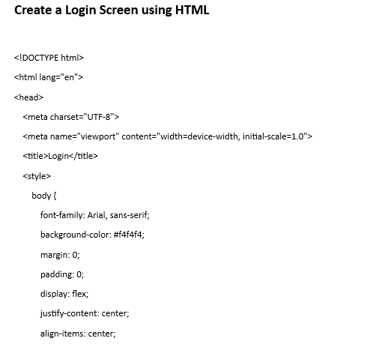

Slide 11
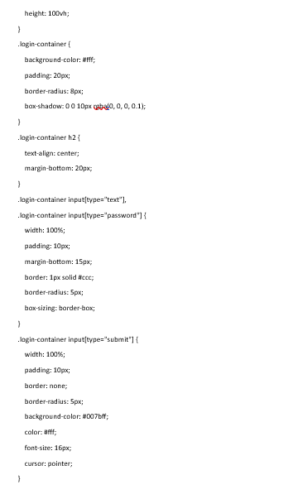

Slide 12
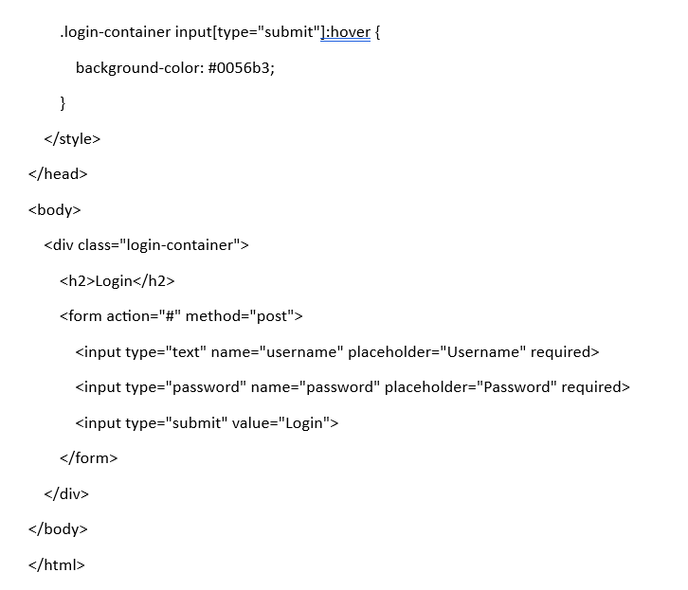

Slide 13
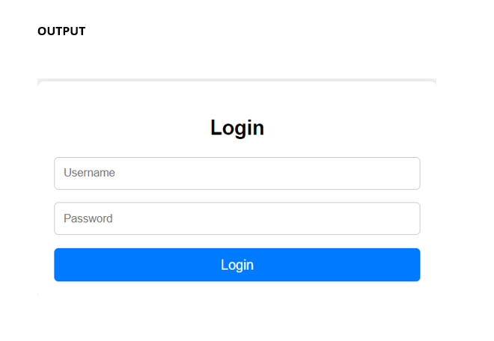

Slide 14
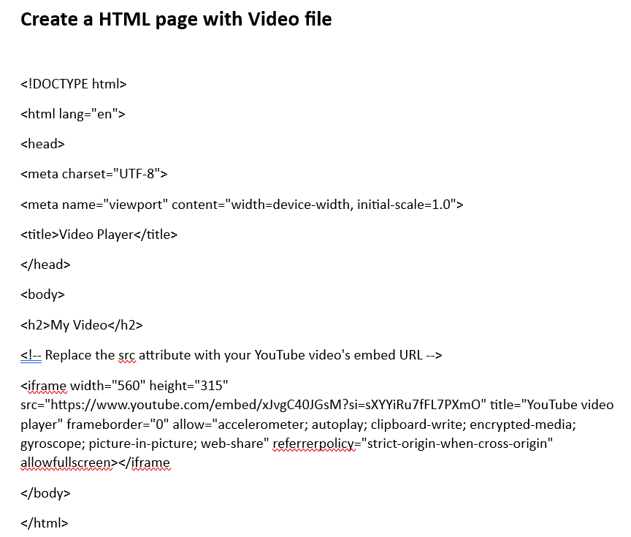

Slide 15


Slide 16
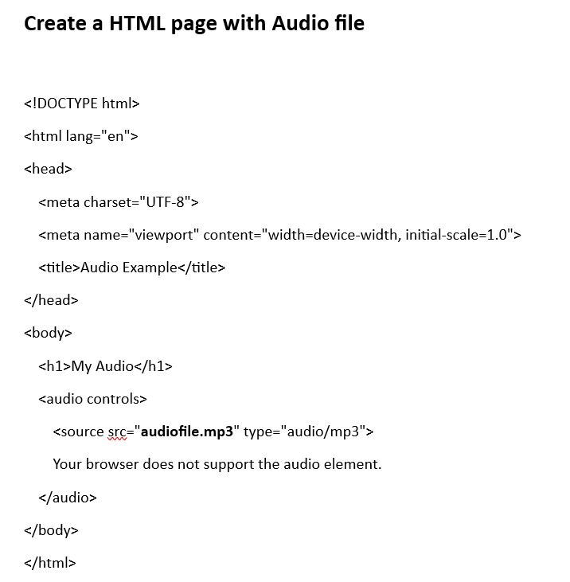

Slide 17
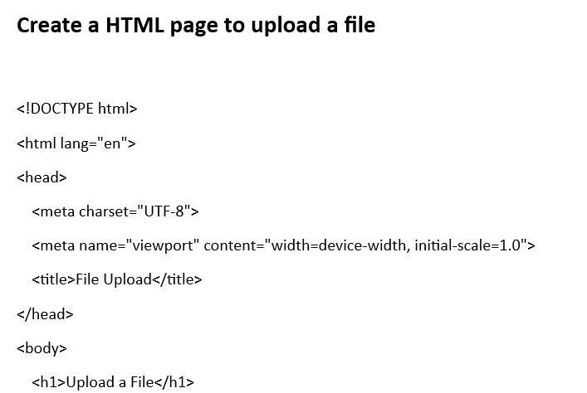
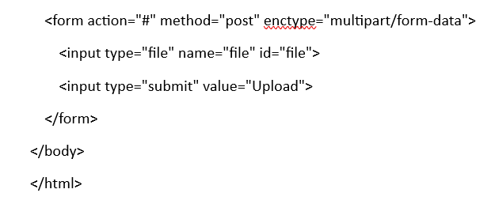

Slide 18
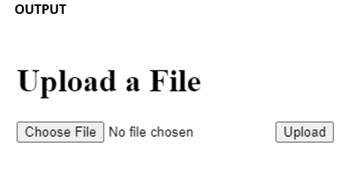

Slide 19
Thank You

